Slide 1
Splunk: Reports, Statistics, Dashboards and Visualizations
SIEMS, Day 3

Slide 2
Class Objectives
By the end of class today, you will be able to:
Use Splunk’s documentation to implement new search commands.
Generate and use reports from Intrusion Prevention System logs.
Perform statistical analysis based on event information.
Use visualization to compare and aggregate event field data.

Slide 3
Day 2 Recap
Last class, we used Splunk to investigate if brute force attacks were occurring at a website.
We looked at the volume of activity at the site and developed a baseline and threshold.
A baseline differentiates between a real attack and normal daily activity.
A threshold is the volume of activity at which an alert is triggered.

Slide 4
Day 2 Recap
Last class, we used Splunk to investigate if brute force attacks were occurring at a website.
We looked at the volume of activity at the site and developed a baseline and threshold.
A baseline differentiates between a real attack and normal daily activity.
A threshold is the volume of activity at which an alert is triggered.
In the first exercise of the day, you will investigate the target of the suspicious activity by looking at the relationship between locked accounts and account and domain names.
Security teams use Splunk’s contingency command to create a contingency table to show the relationship between fields in an event.
These tables help determine root causes, analyze patterns for advanced threat detection, and discover threat actors.

Slide 5
Activity: Contingency Command Warm-Up
In this activity, you will investigate locked accounts using the contingency command.
Instructions sent via Slack.
20 Minutes

Slide 6
Contingency Command Warm-Up

Slide 7
Contingency Warm-Up Review
Write an SPL command that will search for locked accounts.

Slide 8
Contingency Warm-Up Review
Write an SPL command that will search for locked accounts.
Answers may vary:
source=“wineventlogs_baseline.csv” locked

Slide 9
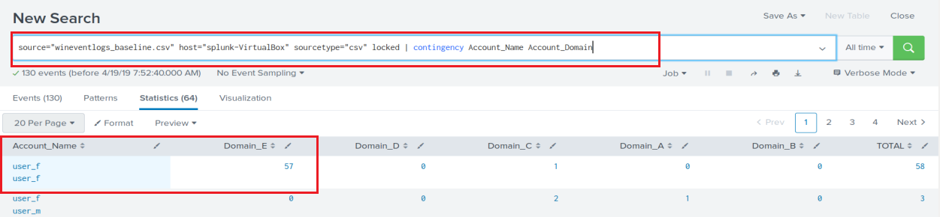
Contingency Warm-Up Review
Contingency tables can be used to detect abnormal activity.
The locked search uses a pipe with the contingency command to gather the search results.
source=“wineventlogs_baseline.csv” host= “splunk-VirtualBox” sourcetype=“csv” locked | contingency Account_Name Account_Domain

Slide 10
Contingency Warm-Up Review
Where was the attacker trying to gain access?

Slide 11
Contingency Warm-Up Review
Where was the attacker trying to gain access?
User_f and Domain_E, which showed 57 locked events.

Slide 12
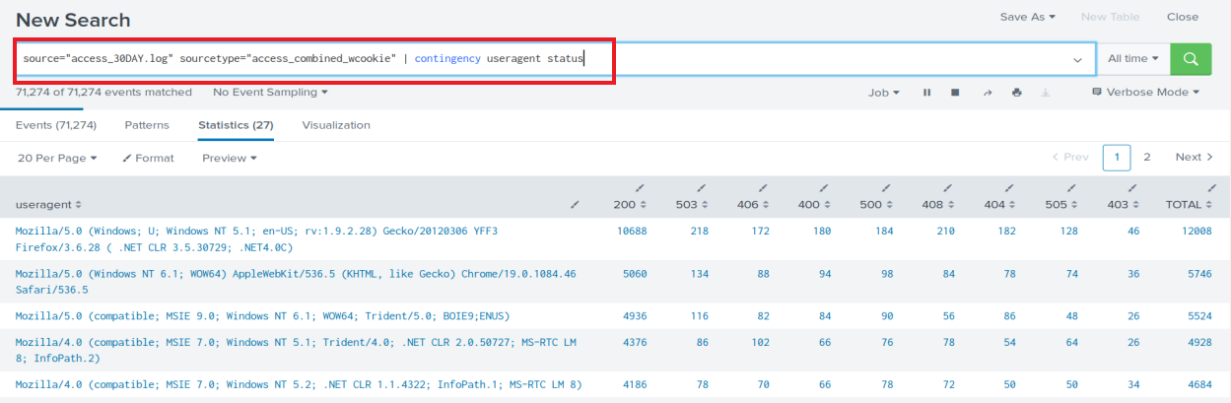
Contingency Warm-Up Review
Additional Challenge: Using the access_30DAY.log file, give another example of where a contingency table can be used such as User agent and status analysis.

Slide 13
Generating Reports in Splunk

Slide 14
Generating Reports in Splunk
Reports are created when you save a search.
Each report contains the events, field and statistical data that was generated from running the SPL search command.
Reports can be run anytime and they fetch fresh search results each time they run.
Reports can be scheduled to run at any interval .
Reports show statistics and visualizations. They can also be used in dashboards.
Reports can be run as historical searches during a security incident investigation.

Slide 15
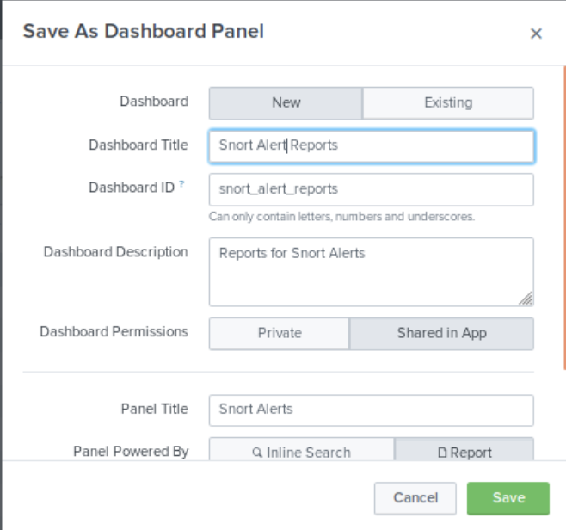
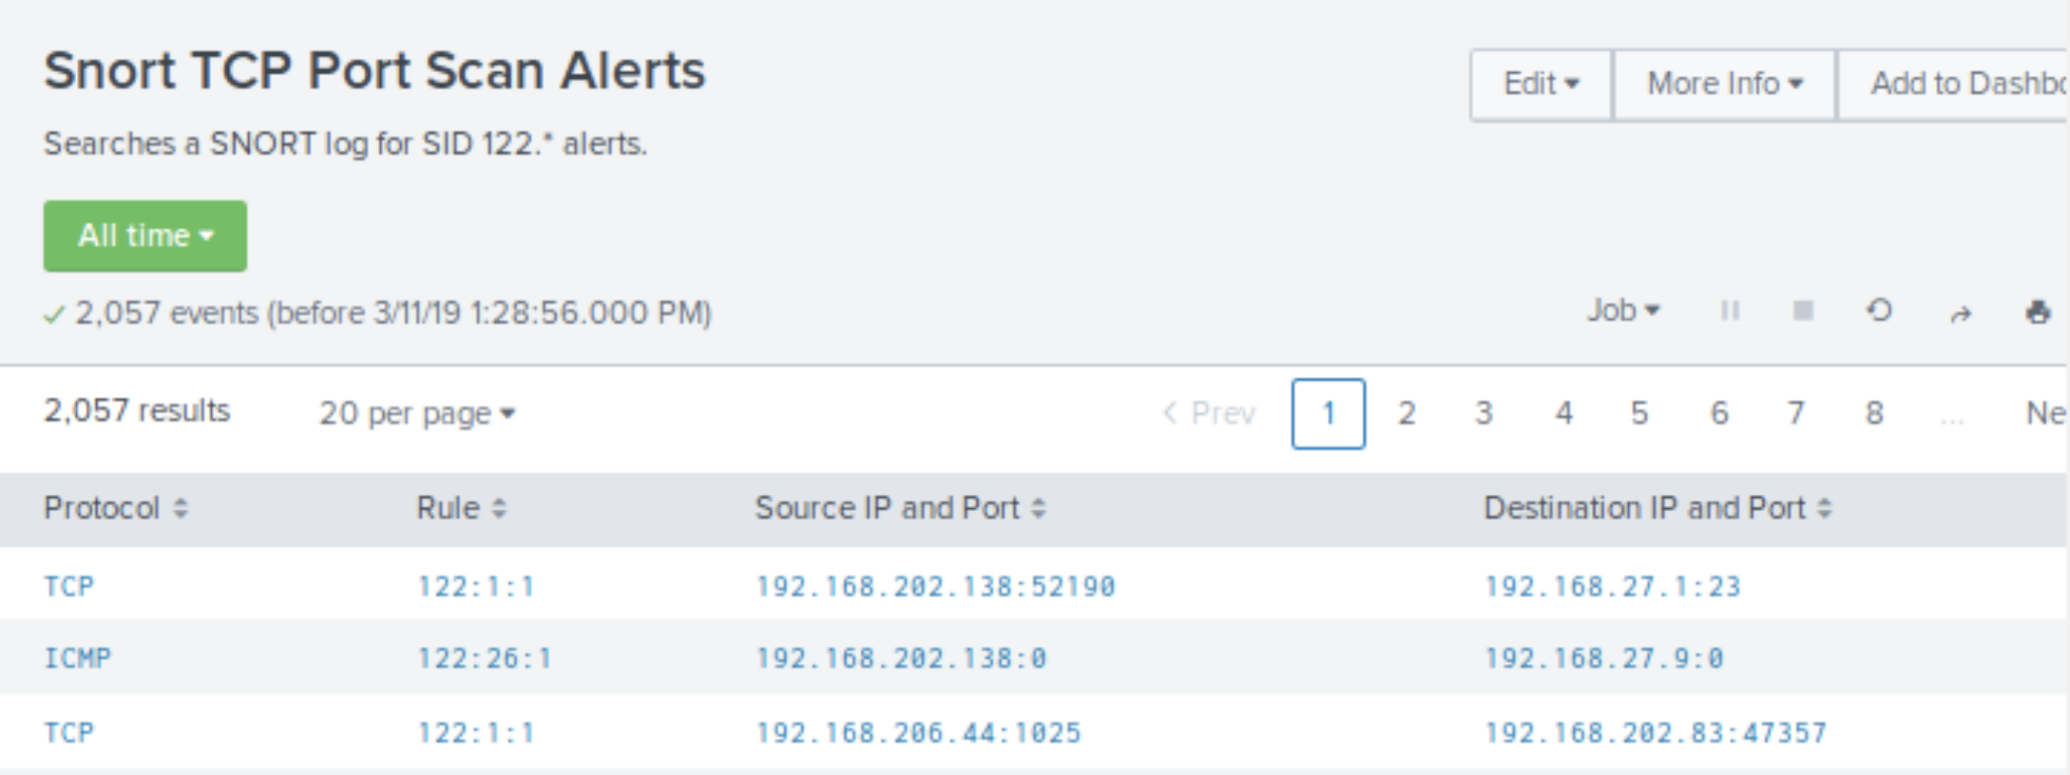
Reports and Dashboards Demo
Now that you’re more familiar with searching in Splunk, the next step is creating reports and dashboards from search results.
Saving a Search as a Report
Adding a Report to a Dashboard
Viewing a Report in a Dashboard
Adding an Existing Search to a Dashboard
Saving the Report to the Snort Alert Dashboard

Slide 16
Generate a Report for Failed Login Attempts

Slide 17
Introduction to the Next Activity:
In the next activity, you will pair up and create a statistical report to analyze events from Intrusion Prevention System(IPS) logs from the Fortinet Security System.
Fortinet provides network, firewall, application and endpoint/device security solutions that can be integrated with Splunk Enterprise.
What is the difference between an IDS and an IPS?

Slide 18
Introduction to the Next Activity:
In the next activity, you will pair up and create a statistical report to analyze events from Intrusion Prevention System(IPS) logs from the Fortinet Security System.
Fortinet provides network, firewall, application and endpoint/device security solutions that can be integrated with Splunk Enterprise.
What is the difference between an IDS and an IPS?
IDS simply monitors where as an IPS can prevent a packet from delivery.

Slide 19

Introduction to the Next Activity:
In the next activity, you will pair up and create a statistical report to analyze events from Intrusion Prevention System(IPS) logs from the Fortinet Security System.
Fortinet provides network, firewall, application and endpoint/device security solutions that can be integrated with Splunk Enterprise.
What is the difference between an IDS and an IPS?
IDS simply monitors where as an IPS can prevent a packet from delivery.
This activity contains a new command called stats, which generates a report that displays summary statistics. Searches return the sum, count, or average of event field data.

Slide 20
Activity: Generating a Statistical Report from Firewall Attack Logs
In this activity, you will create a statistical report to analyze events from Intrusion Prevention System logs.
Instructions sent via Slack.
20 Minutes

Slide 21
Generating Statistical Report from Firewall Attack Logs

Slide 22
Activity Review
There was a lot of information in the attack log for each event. Splunk quickly indexed and extracted the metadata field data.
stats by count <field>, <field>, <field>...
stats is the Splunk command.
count provides the number of events.
field is a field in the event
This is another SPL command that takes the input from a previous command via a pipe.
The command also takes arguments such as sum or average.
Example: | stats by count “scr_ip”, “dst_ip”

Slide 23
Activity Review Part 1: Creating the Search
What fields contain the year(s) for the attack?
Which fields contain the month(s) for the attack?
What is the attack name?
Using the NIST National Vulnerability Database, what does the attack do?

Slide 24
Activity Review Part 1: Creating the Search
What fields contain the year(s) for the attack?
date_year
Which fields contain the month(s) for the attack?
What is the attack name?
Using the NIST National Vulnerability Database, what does the attack do?

Slide 25
Activity Review Part 1: Creating the Search
What fields contain the year(s) for the attack?
date_year
Which fields contain the month(s) for the attack?
date_month
What is the attack name?
Using the NIST National Vulnerability Database, what does the attack do?

Slide 26
Activity Review Part 1: Creating the Search
What fields contain the year(s) for the attack?
date_year
Which fields contain the month(s) for the attack?
date_month
What is the attack name?
Oracle.9i,TNS.OneByte.Dos
Using the NIST National Vulnerability Database, what does the attack do?

Slide 27
Activity Review Part 1: Creating the Search
What fields contain the years for the attack?
date_year
Which fields contain the months for the attack?
date_month
What is the attack name?
Oracle.9i,TNS.OneByte.Dos
Using the NIST National Vulnerability Database, what does the attack do?
“The Transparent Network Substrate (TNS) Listener in Oracle 9i 9.0.1.1 allows remote attackers to cause a denial of service (CPU consumption) via a single malformed TCP packet to port 1521.”

Slide 28
Activity Review Part 1: Creating the Search
Create an SPL search command that searches the firewall IPS event logs using the attack name and returns:
The count of attacks by year and month
Then sorts the counts in descending order
Executes the search using All Time.

Slide 29
Activity Review Part 1: Creating the Search
Create an SPL search command that searches the firewall IPS event logs using the attack name and returns:
The count of attacks by year and month
Then sorts the counts in descending order
Executes the search using All Time.
Add the SPL stats and sort command:
|stats count by date_year, date_month | sort - count
fortinet_logs.csv attack_name=Oracle.9i.TNS.OneByte.DoS | stats count by date_year, date_month | sort - count

Slide 30
Activity Review
2. Creating the Statistical Report
Save the search as a Report with the titler OPS115: Firewall IPS Report
3. Find and Display the Report in the Reports list

Slide 31
Activity Review
2. Creating the Statistical Report.
Save the search as a Report with the title = OPS115: Firewall IPS Report
Click on Save As > Report. Give it a title of OPS115:Firewall IPS Report
3. Find and Display the Report in the Reports list.

Slide 32
Activity Review
2. Creating the Statistical Report.
Save the search as a Report with the title = OPS115: Firewall IPS Report
Click on Save As > Report. Give it a title of OPS115:Firewall IPS Report
3. Find and Display the Report in the Reports list.
Select the Report tab located in the App bar.
Click the Report Title (OPS115: Firewall IPS Report) and Open in Search

Slide 33
Activity Review: Extra Challenge and Report Results
4. How would you obtain the total number of attacks for each month of each year in the attack log?
5. What month(s) and year(s) had the most attacks?

Slide 34
Activity Review: Extra Challenge and Report Results
4. How would you obtain the total number of attacks for each month of each year in the attack log?
Change the sort to sort - date_month
source=“foritnet_logs.csv” attack_name=”Oracle.9i.TNS.OneByte.DoS” | stats count by date_year, date_month | sort - date_month
5. What month(s) and year(s) had the most attacks?

Slide 35
Activity Review: Extra Challenge and Report Results
4. How would you obtain the total number of attacks for each month of each year in the attack log?
Change the sort to sort - date_month
source=“foritnet_logs.csv” attack_name=“Oracle.9i.TNS.OneByte.DoS” | stats count by date_year, date_month | sort - date_month
5. What month(s) and year(s) had the most attacks?
March 2019

Slide 37

Visualizations

Slide 38
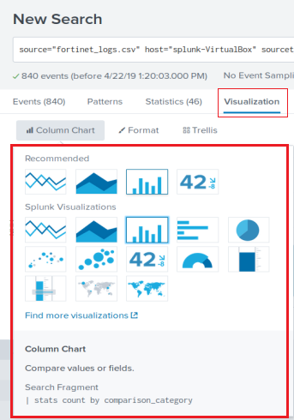
Visualizing Event Data in Splunk
We can create visualization elements such as charts, buttons and maps, and add them to our dashboards.
We have been displaying our data in the Events and Statistics tab, but Splunk provides more useful visual representations, making it easier for Security teams to analyze and interact with data during investigations and day-to-day operations.
These elements are available under the Visualizations tab, where you’ll find options like: bar, pie and bubble charts, radial and filter gauges, and geographic maps.

Slide 39
Single Data and Multiple Data
Visualization elements are selected based on whether the data being represented it a single point data or a multiple point data.
An example of a single data point visualization would be a total count of attacks displayed as a single number.
An example of a multiple data point visualization would be a spreadsheet of counts of attacks, correlated to attack types.

Slide 40
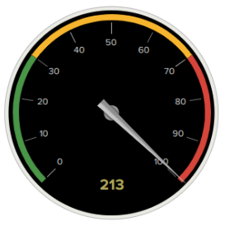
Representing Single Data Points
There are times when a single data point needs to be visualized with severity levels.
For example, if a web application wanted to look at a single data point such as "count of bad logins" over the last hour.
A visualization could illustrate if that data point is currently at a normal, high or critical level.
This visualization can be accomplished by using a Radial Gauge Visualization.
Radial Gauges are similar to what you see in your Car's Dashboard when looking at your car's RPM.
RPM - (Revolutions per minute) is the single data point your car's Dashboard is visualizing.
In your RPM display, if your RPMs reach a certain value, it is typically represented in Red indicating you have reached a level that is too high.

Slide 41
Visualizing Data from Firewall Attack Logs (Single Data Point Visualization)

Slide 42
Student Activity: Single Data Point Visualization
In this activity, you will create visual elements for your Fortinet Firewall Research using a radial gauge.
Instructions sent via Slack.
20 Minutes

Slide 43
Visualizing Data from Firewall Attack Logs

Slide 44
Single Data Point Review
Create a Radial Gauge to monitor the the attack_id=10725 over a one hour period
Set the ranges and colors to values you determine would be appropriate
The query will be:
source= “fortinetlogs.csv” attack_id=“10725” | stats count as total

Slide 45
Multiple Data Point Visualization

Slide 46
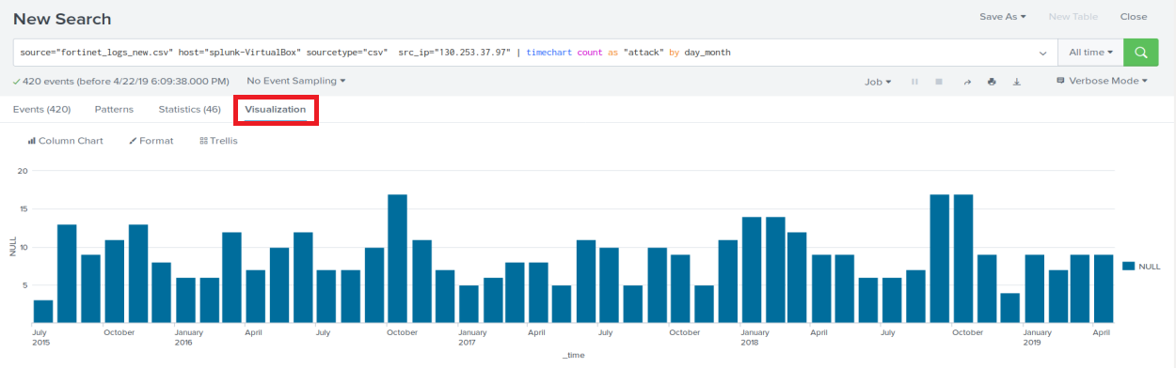
Visualization Demo: Time Chart
In the next demo, we’ll create a time chart and a cluster map using event data from the Fortinet Firewall Attack Log activity.
The timechart command produces trends over time searches.
We’ll create a time chart that displays the monthly activity for all years of the attack.
| timechart count as attack by day_month

Slide 47
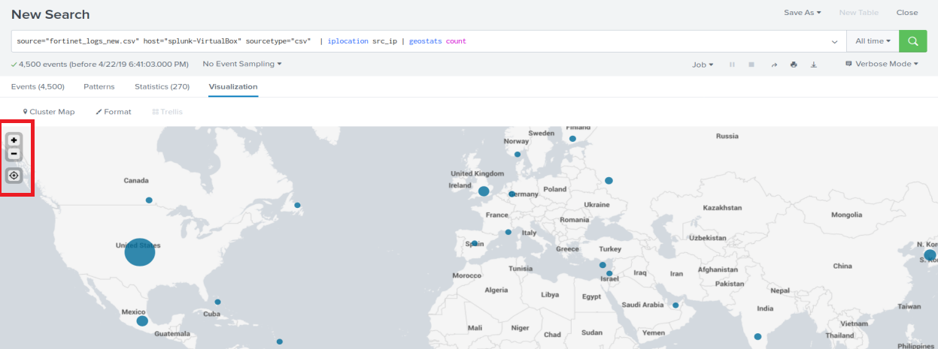
Visualization Demo: Cluster Map
We’ll use iplocation and geostats command to report on the locations of attack activities.
Iplocation command extracts local information from IP addresses.
Iplocation returns City, Country, latitude, longitude and region in event fields
Geostats command takes the IP data and generates statistics which are grouped into geographical data points that can then be rendered on a map.
source="_fortinet_logs_new.csv" | iplocation src_ip | geostats count

Slide 48
Visualizing Data from Firewall Attack Logs (Multiple Data Points)

Slide 49
Student Activity: Multiple Data Point Visualization
In this activity, you will create visual elements for your Fortinet Firewall Research using timecharts, attack counts, maps and area charts.
Instructions sent via Slack.
20 Minutes

Slide 50
Visualizing Data from Firewall Attack Logs

Slide 51
Visualizations Activity Review
Timechart: Create a timechart for the top source IP for the DOS attacks by month.

Slide 52

Visualizations Activity Review
Timechart: Create a timechart for the top source IP for the DOS attacks by month.
| src_ip=“130.253.37.97” | timechart count as “attack” by day_month

Slide 53
Visualizations Activity Review
Attack Count: Generate the count (420) using the stats command.

Slide 54
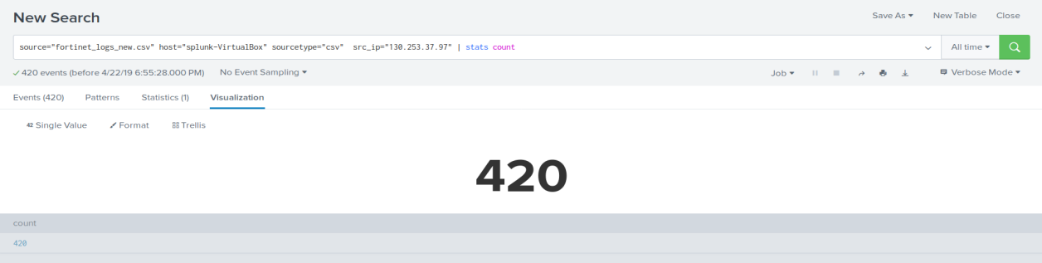
Visualizations Activity Review
Attack Count: Generate the count (420) using the stats command.
src_ip=“130.253.37.97” | stats count
Then, under the visualization tab, select Single Value.

Slide 55
Visualizations Activity Review
Map: Generate a map for only the top IP source.

Slide 56
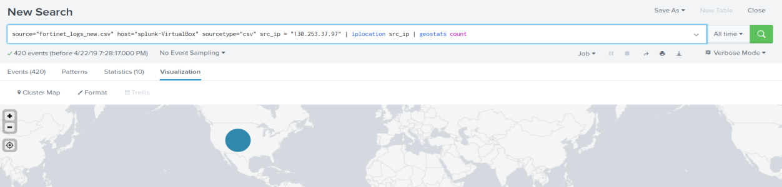
Visualizations Activity Review
Map: Generate a map for only the top IP source.
src_ip=“130.253.37.97” | iplocation src_ip | geostats count

Slide 57
Visualizations Activity Review
Area Chart: Generate an area chart that displays the targets of the attack for the source IP address.

Slide 58
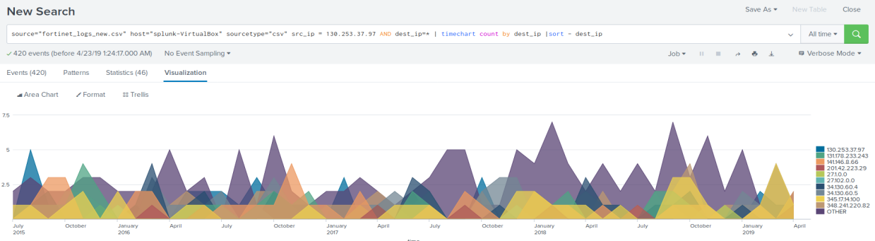
Visualizations Activity Review
Area Chart: Generate an area chart that displays the targets for the attack for the source IP address.
src_ip=“130.253.37.97” AND dest_ip=* | timechart count by dest_ip | sort - dest_ip

Slide 59
Working with Splunk Dashboards

Slide 60
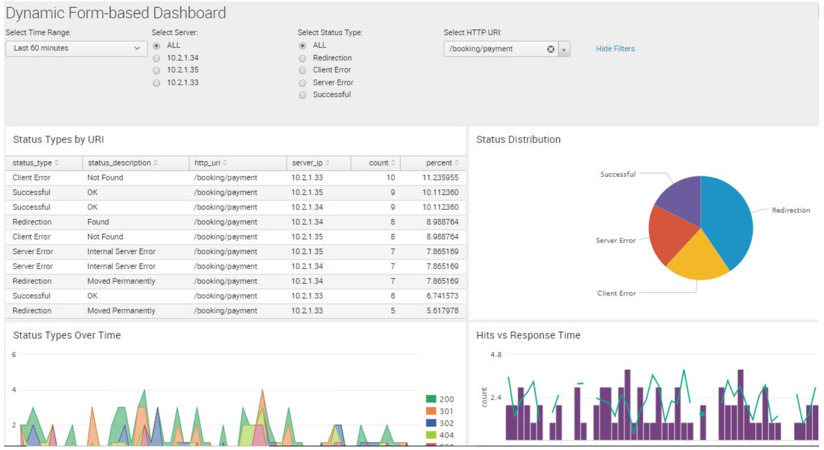
Splunk Dashboards
Dashboards integrate elements in panels to display the most relevant information for different teams and use cases.
Dynamic form-based dashboards allow for modifications using radio, buttons, and check boxes.
Real-time dashboards are displayed on panel
screens for constant viewing in network and
security operations centers.
Dashboards as scheduled reports can be
saved as a PDF file or sent as emails to
NOC or SOC teams at scheduled.

Slide 61
Adding an Existing Search to a Dashboard

Slide 62
Activity: Create a Dashboard for Failed Password Attempts
In this activity, you will create a Linux and Windows Failed Password Dashboard for Monitoring login attempts by an SOC Team.
Instructions sent via Slack.
15 Minutes

Slide 63
Create a Dashboard for Failed Password Attempts

Slide 64
Class Objectives
By the end of class today, you will be able to:
Use Splunk’s documentation to implement new search commands.
Generate and use reports from Intrusion Prevention System logs.
Perform statistical analysis based on event information.
Use visualization to compare and aggregate event field data.

Slide 65
Any Questions?

